Slide 1
Transform Your Travel & Expense Management with Norming Solutions for Sage 300

Slide 2
Agenda
Norming Solutions Introduction
Challenges in Travel & Expense Management
How Norming Solutions Addresses These Challenges
Product Features & Benefits
Next Steps
Notes:
In this session, we will do a short introduction about Norming and its products, we will then move on to share the key challenges in Travel and Expense Management, and how those challenges can be addressed by Norming’s travel and expense solution.

Slide 3
Norming Solutions Introduction

Slide 4
Problem
Businesses relying on manual or fragmented systems for procurement, expense management, and cross-departmental workflows face significant inefficiencies, including delayed approvals, compliance risks and budget overruns. These challenges hinder scalability, collaboration and growth.
Notes:
Today, Technology has been advanced a lot. But a lot of business still using manual or Fragmented systems which lead to silos in business operations. Norming team understand these challenges and has been developing solutions to address these problems.

Slide 5
Solving the problem with Norming
Automated Web/Mobile Workflows
Streamlines Purchase to Pay, travel & expenses, project scheduling, and sales quotations and multi-level
approval workflows through web portal or mobile devices
Improved Visibility and Accountability
Integrates with Sage 300 ensures transparency across departments (Purchasing, Warehouse, Finance, Sales)
Key Outcomes
Faster approval cycles
Compliance & Security
Better Collaboration
Paperless
Cost-Effective Scalability
Notes:
Using web and mobile solution, Norming automate the procure to pay, travel and expense management, sales and warehouse operations, project scheduling to help business to streamline its operations, improved collaborations. You will be able to find out how Norming achieve this in the sharing later.

Slide 6
About Norming
A Key ISV of Sage
Our Products
Our Awards
20+ years with sage
700+ business partners
6000+ active clients
Norming Asset Management
Top Independent Software Vendors (ISVs) in Sage community
Earned numerous awards
Norming Resource Manager
Norming Security Suite
Norming HRMS
Notes:
Some of you might have know who is Norming, Norming is an independent software vendor who has been developing a lot of add on solutions to Sage 300 which you will see in the next few slides.
Over the past 20 years, Norming has been recognised globally by Sage partners with their robust solutions and reliable support, and won numerous awards in the past 20 years.

Slide 7
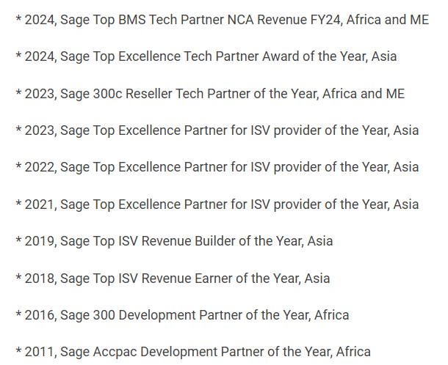
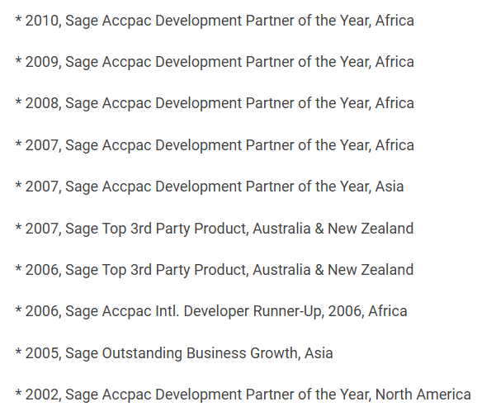
Awards

Slide 8
PRODUCT OVERVIEW
Assets Management
Manage all asset-related information, asset accounting, maintenance, leasing and tracking in one centralized system sage 300, providing easy access and visibility.
Norming Assets Management
Notes:
Most of you might have been using Norming’s asset management products, which help you to manage all asset related operation and accounting aspects which covers accounting, maintenance, tracking and asset leasing.

Slide 9
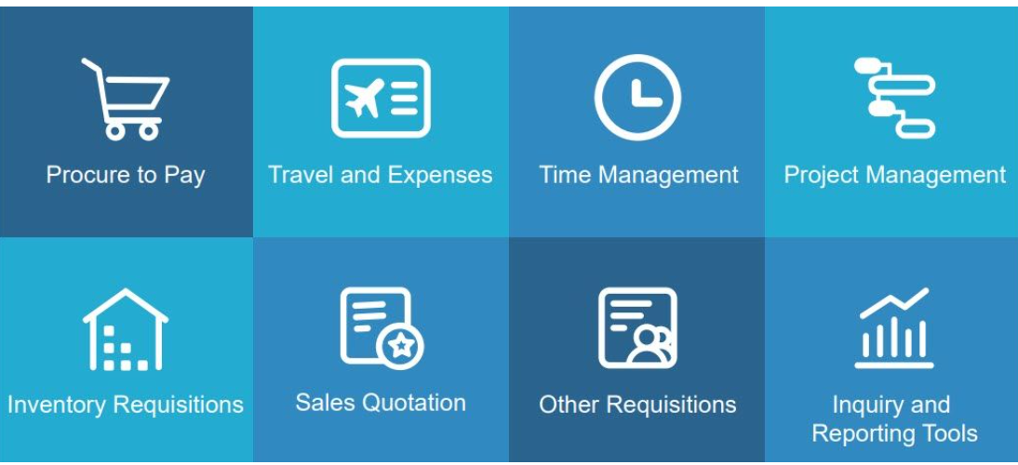
PRODUCT OVERVIEW
Resource Manager
Streamline and optimize workflow processes from travel & expenses, procurement to pay, time management, sales quotations, projects and job costing, or custom requisitions
Norming Resource Manager
Notes:
Norming resource manager was initiatively developed from the customer and partner’s request, while the customers appreciate the rich and roust operations in Sage 300 AP, PO, OE and IC, but it not end-user friendly and operational feasible for end-users to be trained and use the Sage 300 core modules.
Bear these requests in mind, Norming developed Norming Resource Manager which covering from procure to pay, employee travel and expense, time sheet and project management as well as other requisitions like Sales quote, inventory item requisitions.

Slide 10
PRODUCT OVERVIEW
Security Suite
Norming Security Suite sets security at the transaction level, allowing certain users or user groups to access or process only specific types of transactions.
AP Security | IC Security | Purchase Security
AR Security | Sales Security | Bank Security
Norming Security Suite
Notes:
Norming continues listening to partner and customers feedback,
some of the companies’ operations need very strong security controls like certain sales person can only have the access to selected customers
and certain buyers can only access to selected vendors,
Norming’s security suite allows you to set security control at the transaction level.

Slide 11
Norming Resource Manager – Scaling Sage 300 Beyond Finance
Norming Inventory Requisition
Web Item Usage Requisition
Web Stock Transfer Requisition
Norming Procure to Pay
Web Purchase Request
RFQ
Web PO Receipt
Web PO Invoice
Web AP Invoice
Web AP Payment
AP Automation (AI Powered OCR)
Web Sales Quotation
Order
Entry
Inventory
Control
Purchase
Order
Norming Travel & Expenses
Web Travel Request
Cash Advance
Expenses Claim
Expenses Reimbursement
Norming Additional Requisition
Web GL Journal Entry Requisition
Manager Console
Web AR Invoice Requisition (New)
General
Ledger
Accounts
Payable
Norming Custom Requisition
Web New Vendor Onboarding
User specific workflows
Norming Project & Time Management
Web Timesheet
PJC Estimate Revise Requisition
Project Scheduling
Resource Planning
LEM Report
Accounts
Receivable
Project
Job Costing
Notes:
This diagram shows how Norming Resource Manager can scaling Sage 300’s core financial operations to front end users,
as you can see from the diagram, the green circles are all Sage 300 modules, and all the functions listed in the blues boxed are mobile and web-based Norming Solutions.
These solutions enable staff work from anywhere and anytime, reduce the manual data entries and help business go paperless work flows.
With Norming resource manager, you can enjoy the automated workflows seamlessly integrated with robust Sage 300 financial back end operations.
If you would like to find out more about these solutions, please indicate your request in the post event survey.

Slide 12
Robust and Flexible Workflow Engine
Applications
Flow
Start
End
Purchase Request
Application
Approval
Purchase Order
Start
End
Application
Approval
Approval
Travel Request
Start
Approval
End
Expense
Application
Approval
Approval
Payment
Notes:
Different companies need different workflows for the operations.
Norming resource manager provides robust and flexible work flow set up.
For the simplest workflow, you can have 1 level of approval where the applicant apply the request and approved by 1 approver.
You can also have 2 levels of approval, meaning to say there is another approval level after the application being approved by the 1st approver.
Or alternately, you can also set the application with some conditions, says the amount below 10,000 is to be approved by Manager while above 10,000 is to be approved by Financial Controller/CFO.
Anyway, Norming supports unlimited levels of approval and customizable approval workflows.

Slide 13
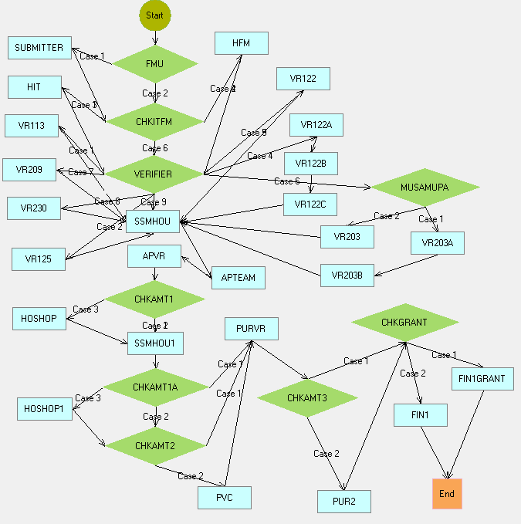
Complex Approval Workflow
Able to handle complex multi level approval workflow
Notes:
This is one of the complex Approval Workflow used by one of the Norming customers.
Norming Resource Manager proven able to handle complex approval workflow requirement.

Slide 14
AI Powered OCR AP Automation
Upload/email Invoices
Auto 2-/3-way invoice matching
Invoice
Verification&
Approval
sage 300
OCR
Automate your AP Invoice capturing and approval with new Technology!
Notes:
Norming continues to advance its solutions and adopting the latest technology. The AI-powered OCR automates the vendor invoice capture, helping customers to do away with manual data entry.

Slide 15
Challenges in Travel & Expense Management
Notes:
Let’s move on to one of the Norming’s solutions – Travel and Expense Management.

Slide 16
Survey Results
Notes:
Based on the survey completed by all of you, most of us are still manage our travel and expense manually which brings a lot of challenges!

Slide 17
Survey Results
Notes:
These are the key challenges we are facing with travel and expense management – the top 1 is the process delays, followed by inefficient approval workflow, budget control, policy compliance, errors and so on.

Slide 18
Manual Travel Process Workflow and Challenges
Employee fills out manual form
Unclear policy
Request submission
Incomplete forms
No visibility on approval status
Approvers’ review and approve
Approver unavailable
Missing details may cause rework
Finance endorsement
Booking travel arrangements
Delay
Real time budget visibility
Real time budget visibility
Policy Non-Compliance
Price changes may trigger re-approval
Poor employee experience
Poor employee experience
Overspending risks
Inconsistent Decisions
Notes:
This is a typical manual process flow and the challenges, based on my work experience, most of the staff are not aware of the policy, and they feels frustrated start from form filling, after struggles and asking around, they fill in whatever they think it’s necessary and then submit to their managers.
Again the manager might not be able to remember all the details in the policy, the manager might take longer time to approve.
During the whole approve process, unclear policy, approvers’ traveling schedule and lack of budget visibility might cause delays through out the whole process cycles.
As there are no system in place to for policy enforcement, approvers needs to inform the staff about non-compliance, this might make both staff and approvers feel uncomfortable. No need to mention the worse case scenarios like re-approval is required due to price change or incomplete forms submitted.

Slide 19
Manual Expense Process Workflow and Challenges
Manual retrieve of manual TR
Loss
Employee collects and submits receipts
Incomplete forms
No visibility on approval status
Approvers’ review and approve
Approvers unavailable
Missing details may cause rework
Finance processes reimbursement
Rejections & Resubmit
Manual data entry → High risk of errors
Unclear receipts → Time-consuming validation
Policy Non-Compliance may trigger re-approval
Poor employee experience
Errors
Inconsistent Decisions
Risk of lost/misplaced receipts
Exchange rate disputes
Redundant validations & approvals
Errors
Incomplete Forms
Policy Non-Compliance
Time-consuming
Slow reimbursements →Employees face financial strain
Overspending
Notes:
Similarly – delays always happen in the manual based process expense claim. In addition, staff might not be able to retrieve the original travel request approved, the receipts might be lost and tedious currency conversion. When I was the finance and admin manager, checking employee’s expense claim was a nightmare tasks – not able to find the matching receipts, or faded receipts, calculating the entries one by one, especially when most of the staff only submit their expense claim close to the submission deadline, and the clashing with the sudden urgent ad-hoc reporting requested by management and HQ. What a night mare!

Slide 20
How Norming Solutions Addresses These Challenges
Notes:
The great news is now you can have Norming to help you to streamline and automate these tedious processes.

Slide 21
How Norming’s Travel and Expense Solution Address The Challenges
Challenges | Norming Solution | Details
Process delays | Automated Mobile/Web-based Workflow | Automates the submission and approval workflows for travel requests and expense claims, reducing manual intervention and speeding up processes Provides mobile access for on-the-go approvals and submissions, ensuring timely processing Auto-reminders
Approval workflow efficiency | Configurable Approval Paths + mobile/delegated approval | Offers powerful and flexible workflow configurations, allowing for automated policy checks and dynamic routing based on expense amount or category Delegated approval
Budget control | Real-Time Budget Tracking | Automatically tracks expenses against predefined budgets, providing real-time updates on remaining funds for each expense category Alerts users if expenses exceed policy-defined thresholds
Lack of visibility | Traceable Approval Status + Comprehensive Reporting | Offers real-time tracking of travel requests and expense claims Managers can review and approve reports efficiently
Policy enforcement and compliance | Built-In Policy Checks | Enforces mandatory fields to ensure completeness before submission Built-in policy compliance checks help prevent unauthorized claims
Errors/Incomplete Forms | Automated Data Entry/Mandatory fields | Ensures accurate data entry through mobile receipt capture and structured forms Reduces manual calculations, preventing errors
Data reconciliation and integration with Financial System | Seamless Integration with Sage 300 | AP: Automatically convert expense reports into invoices that can be processed in the AP system, reducing manual entry errors. GL: Automatically categorize expenses to the appropriate general ledger accounts
Handling of multi-currency transactions | Multi-Currency Support | Handling expenses in various currencies, with automatic conversion based on current exchange rates
Notes:
Now let’s see how these key challenges can be addressed by Norming’s Travel and expense solution. The table is a bit of busy, but I think it’s very important to make it clear that how Norming can help.
Due to the time constraint, I will not read through them one by one, the slides will be shared with you after the session.
Web/mobile based workflow can help with the process delay, configurable workflows and delegation improve the workflow efficiency, real time budget tracking can minimise the overspending and requestor can see the full approval trail.
The policy can be built in and validated during the submission, and the great news to Finance department, the expense entries can be posted directly to Sage 300 AP or GL modules based on the mapping during the implementation stage.

Slide 22
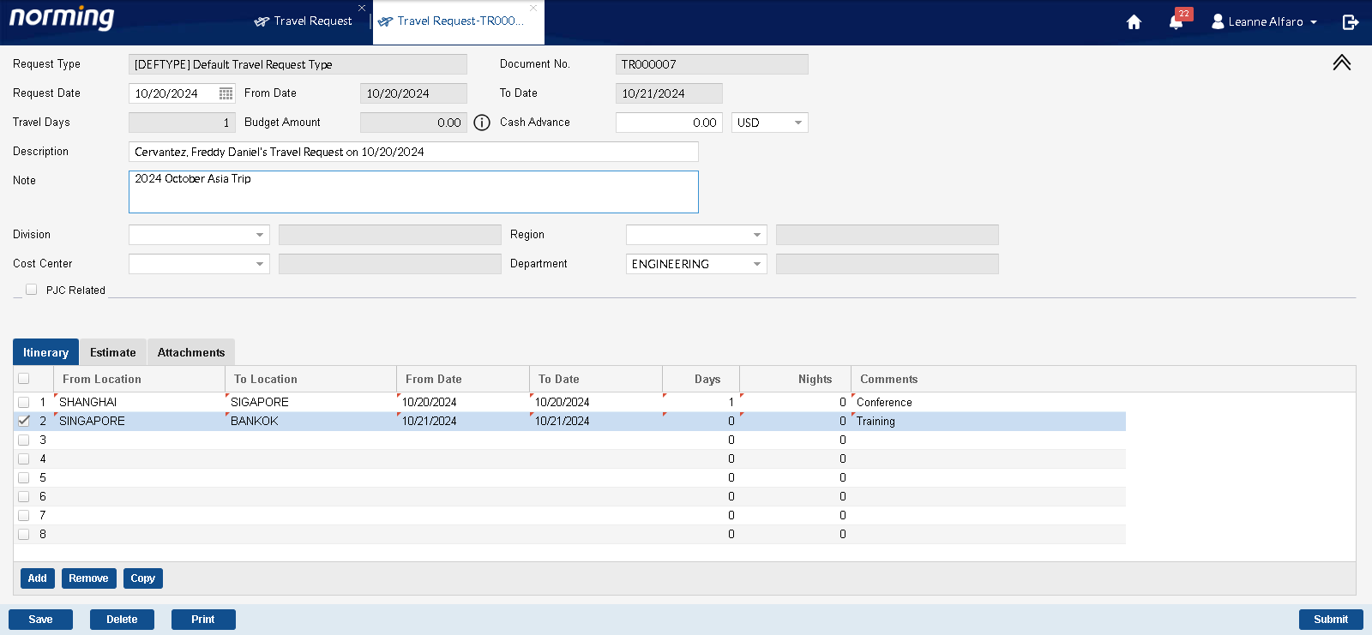
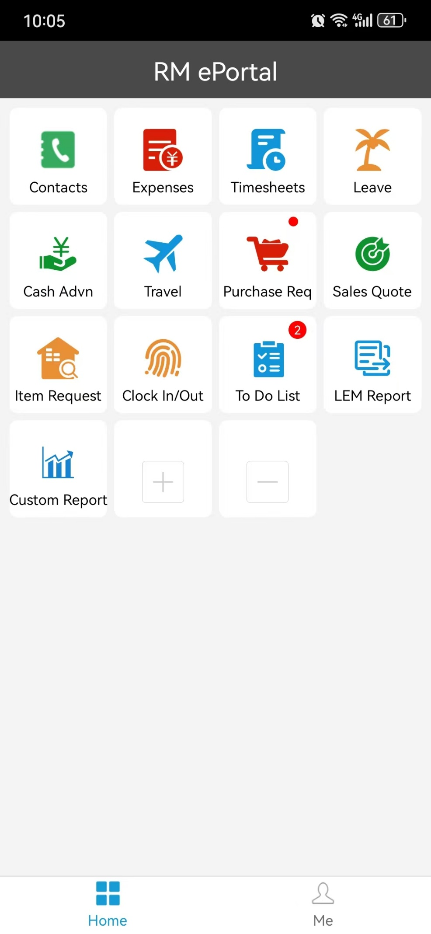
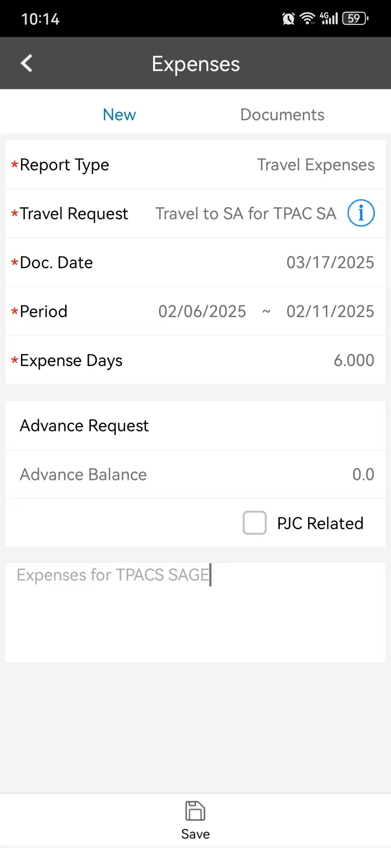
Process delays Automated Mobile/Web-based Workflow
Users can submit travel request or expense claim through web or mobile app.
Notes:
Now let’s take a look of what are the key features to address each challenge. Staff can submit travel request or expense claim on the go using web portal or mobile app. Once the travel request or expense claim is submitted, the approver will receive the email notification with the link to direct them to the request to approve accordingly.

Slide 23
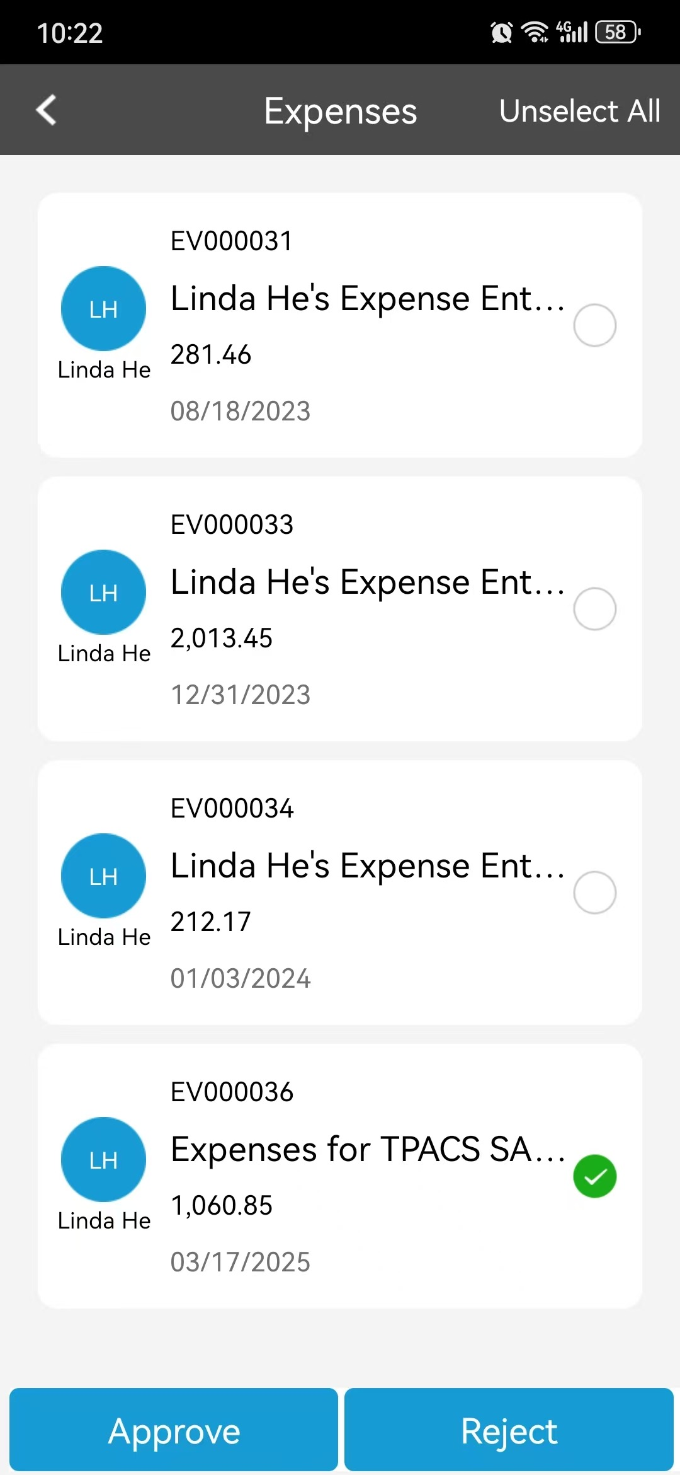
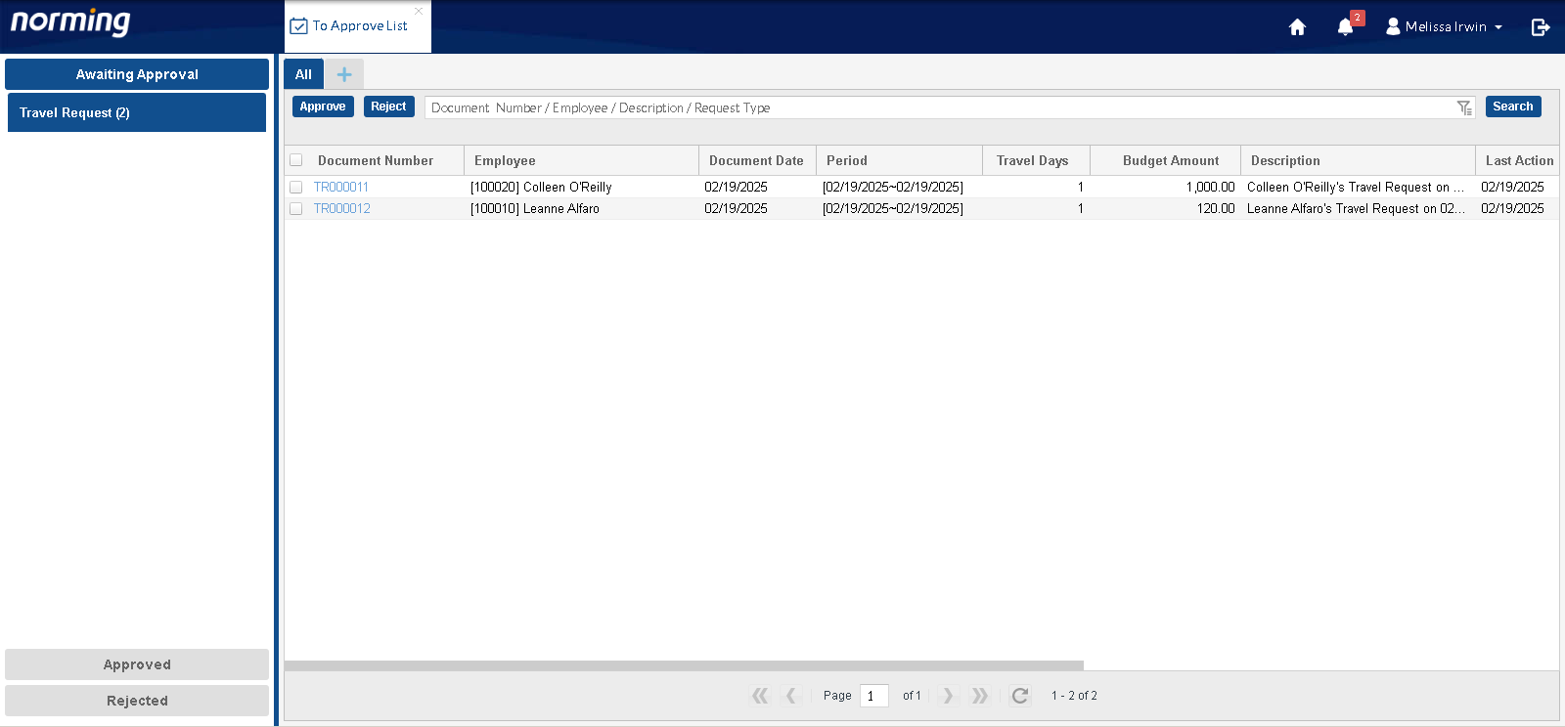
Process delays Automated Mobile/Web-based Workflow
Approvers can access to be approval list from web screen or mobile app.
Notes:
All the pending requests are displayed on 1 screen in the web portal or mobile apps, easy for the managers to review and approve.

Slide 24
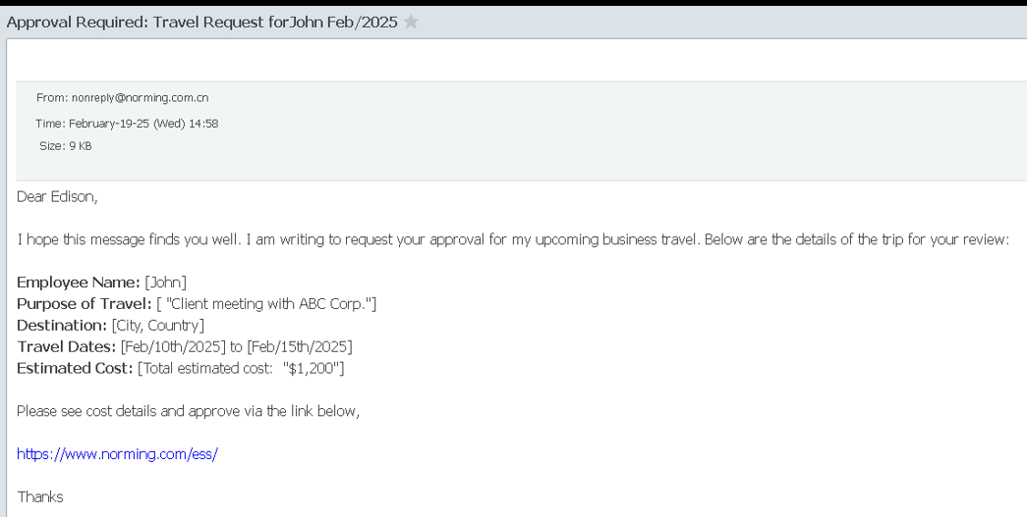
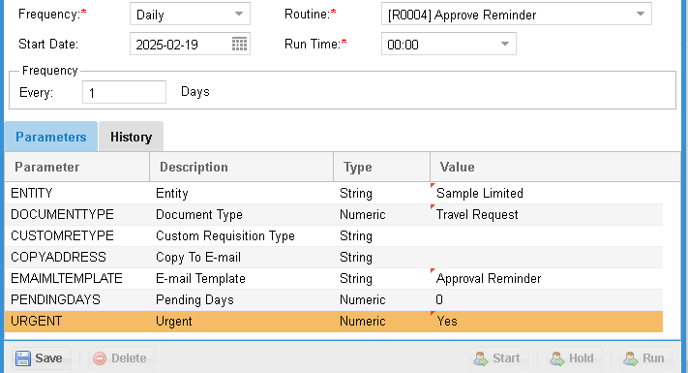
Process delays Configurable Auto-reminders
Auto-reminders can be set to prevent delays.
Notes:
To prevent the managers overlook the approval requests, the system allows you to set up the auto-reminders to be sent out daily or other frequency.

Slide 25
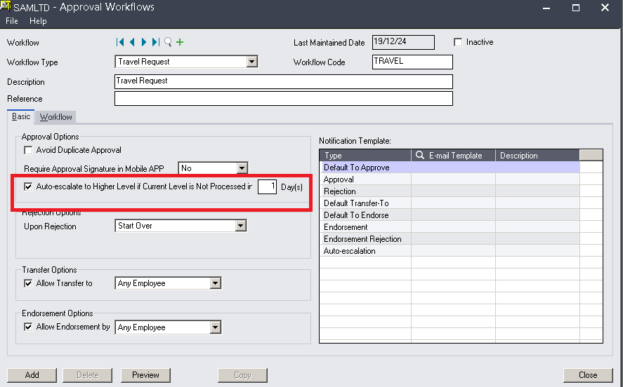
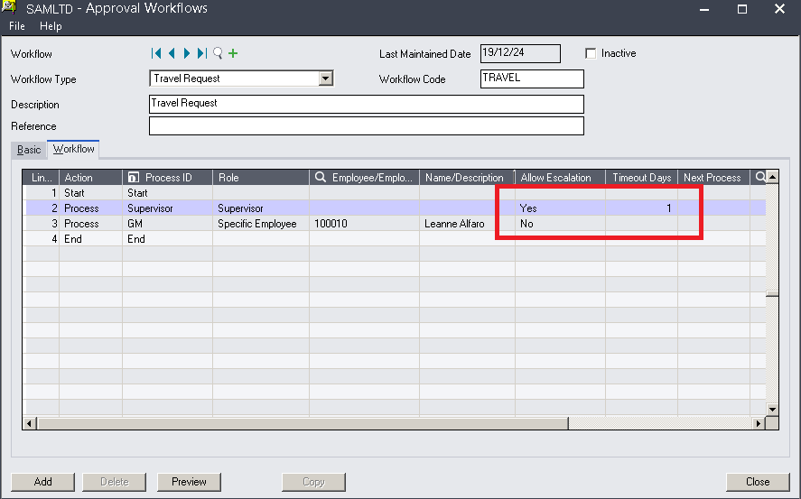
Process delays Configurable Auto-reminders
The system allows escalations for requests not approved timely.

Slide 26
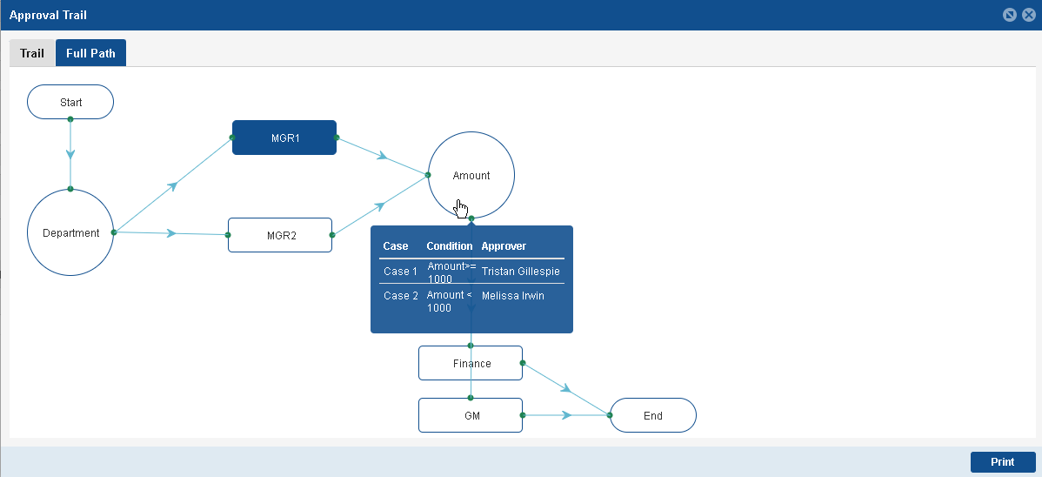
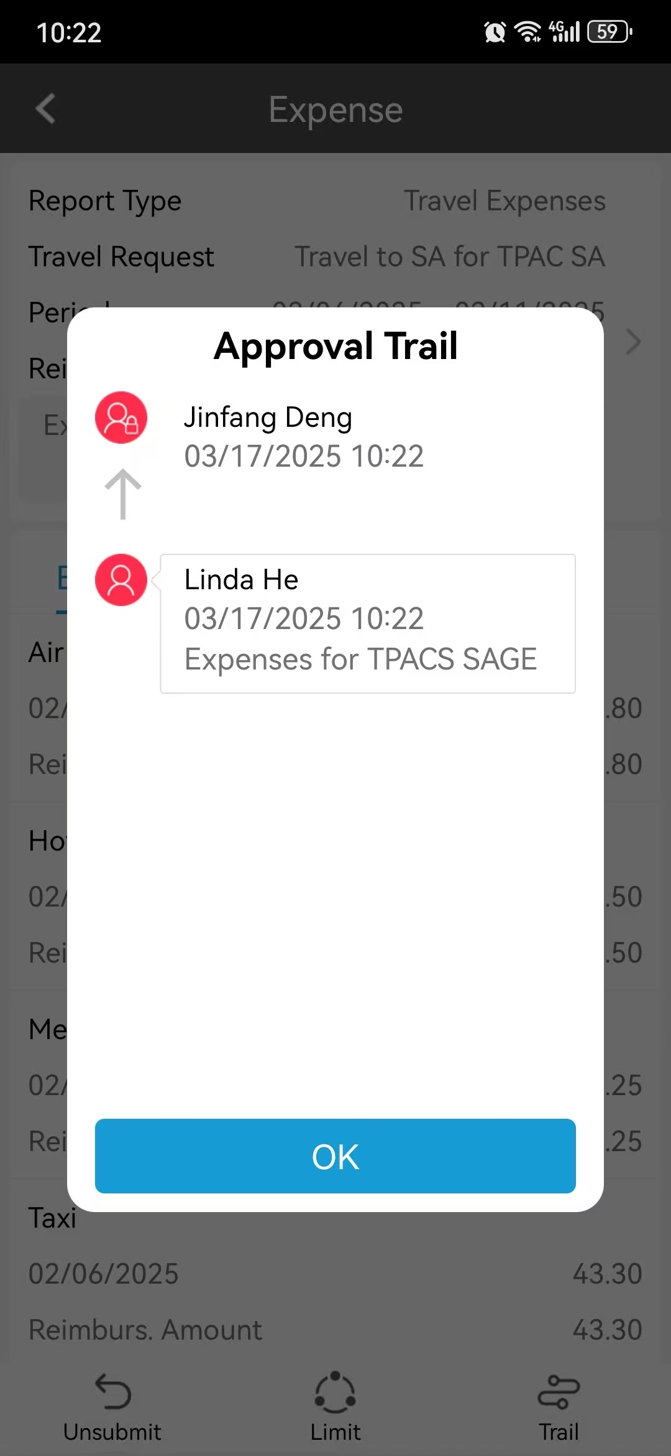
Approval workflow Efficiency
Configurable Approval Paths + mobile/delegated approval
Notes:
To help the customers to improve the workflow efficiency, the approval workflow can be configured based on company’s policy to reduce approval redundancy. Transparent approval trail helps to improve efficiency as well.

Slide 27
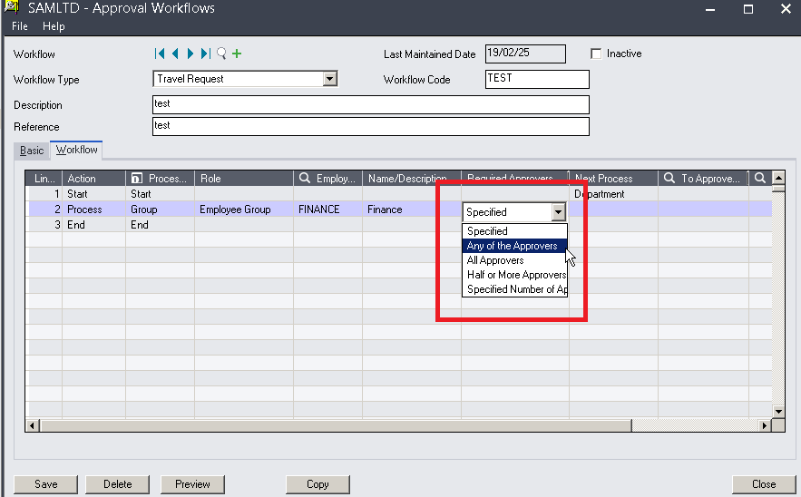
Approval workflow Efficiency
Configurable Approval Paths + mobile/delegated approval
Notes:
You can configure the approval workflow by specific amount or multiple approvers required.

Slide 28
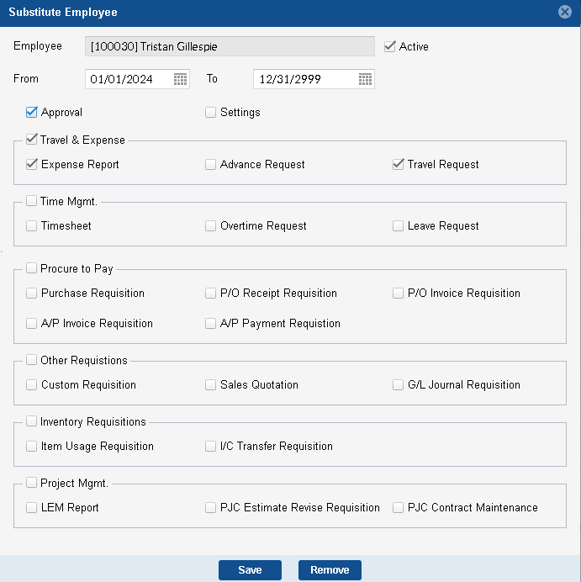
Approval workflow Efficiency
Configurable Approval Paths + mobile/delegated approval
Approvals can be delegated
Notes:
To avoid the delay, you can delegate the approval requests when you are travel or on leave.

Slide 29
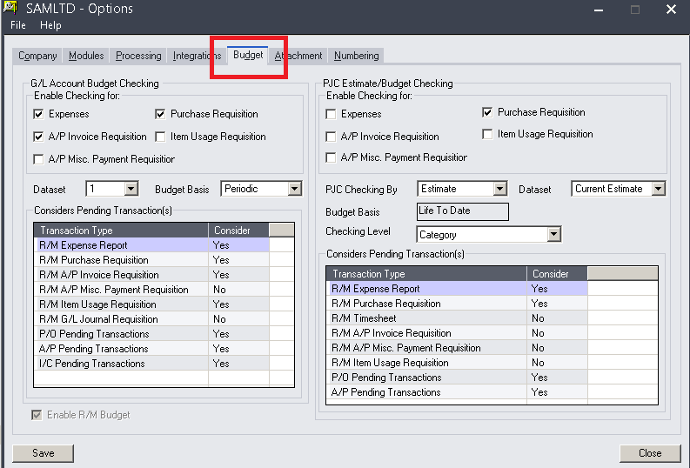
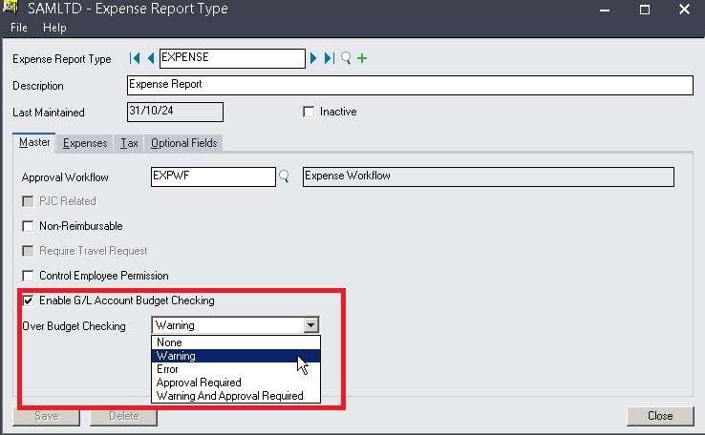
Lack of Budget Control Real-Time Budget Tracking
Cost control can be linked to GL or PJC
Notes:
For better budget control, you can enable GL account budget checking or Project Job cost estimate or budget checking.

Slide 30
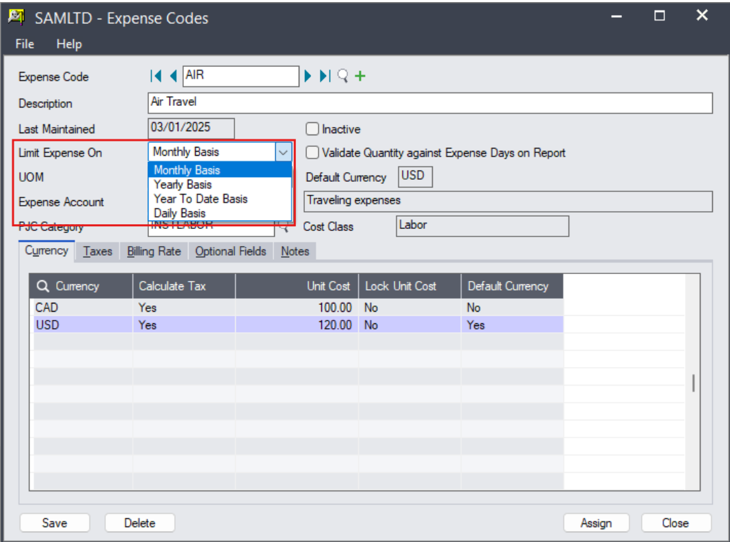
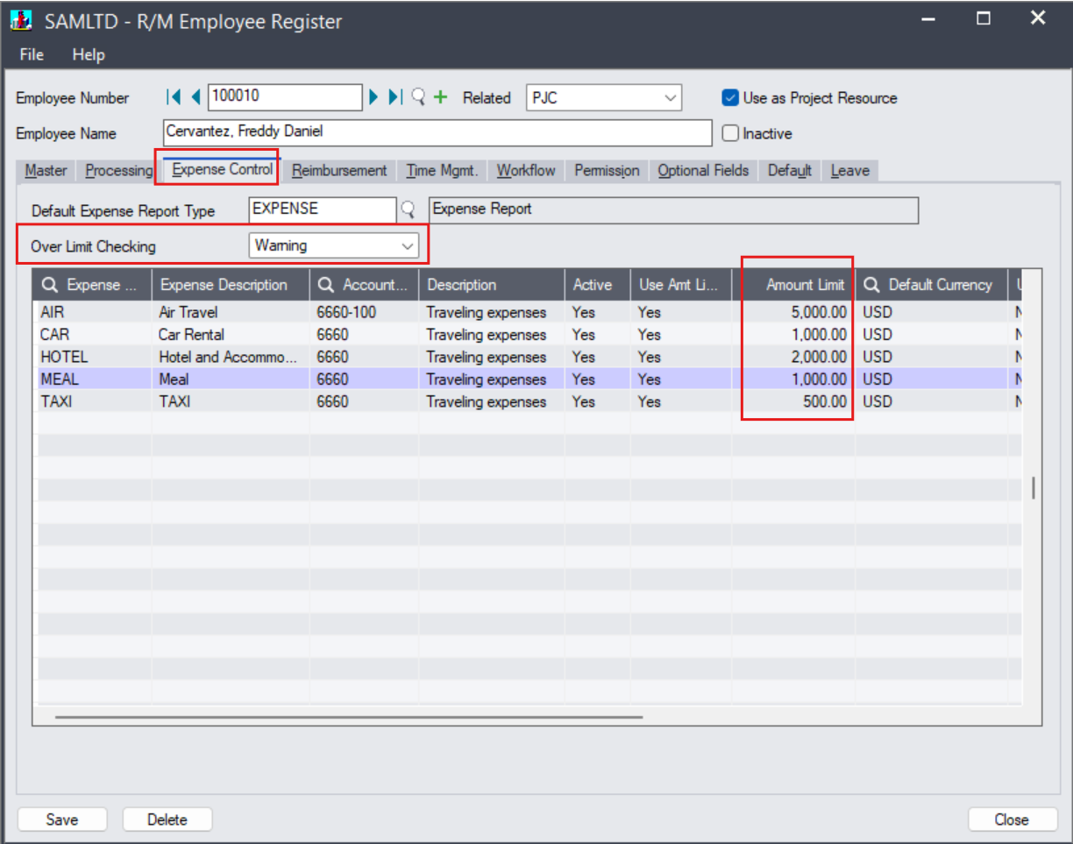
Lack of Budget Control Real-Time Budget Tracking
Limit the spending by expense and enable the checking by daily, monthly, yearly or year to date
Notes:
You can even set the amount limit by expense code on monthly or yearly basis. The system will valid the budget limit during the submission, if the limit is exceeded, you will get warning message or error, or approval required.

Slide 31
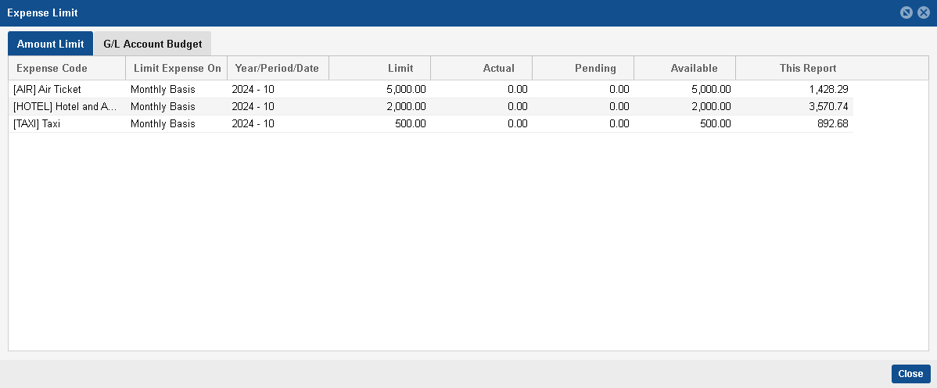
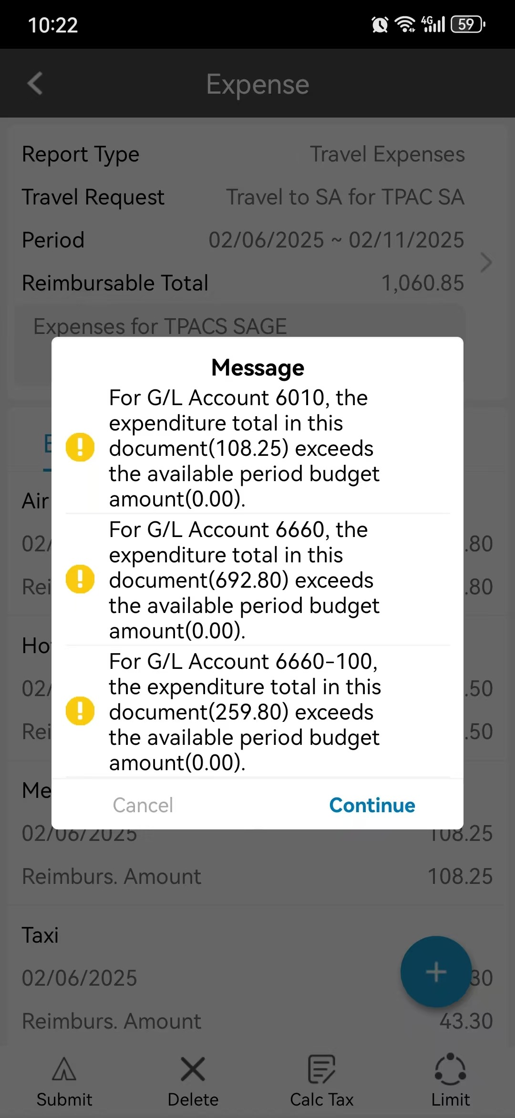
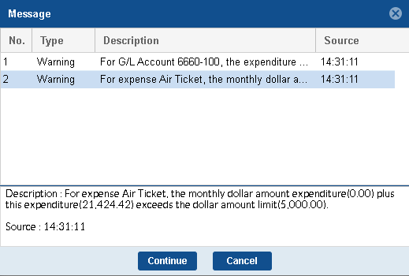
Lack of Budget Control Real-Time Budget Tracking
Notes:
Alerts are activated based on the limit and checking frequency

Slide 32
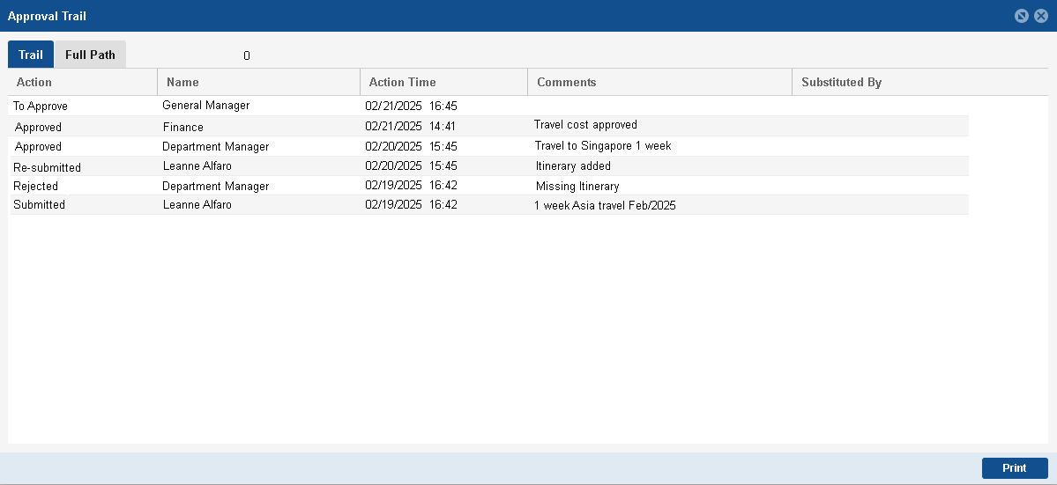
Lack of visibility Traceable Approval Status
Notes:
The requestor can always check the status of the requests through approval trail.

Slide 33
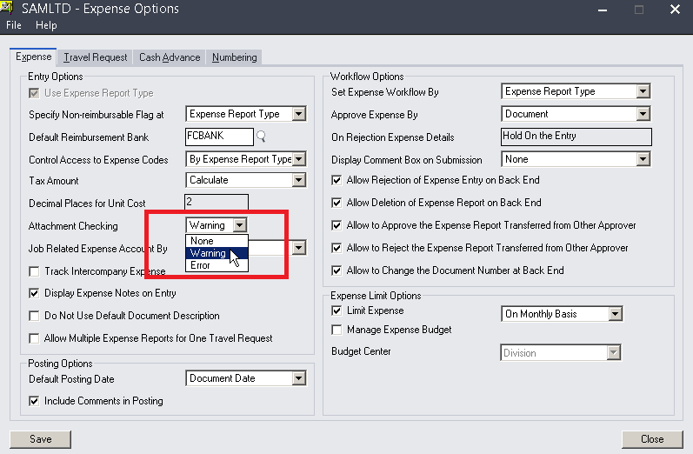
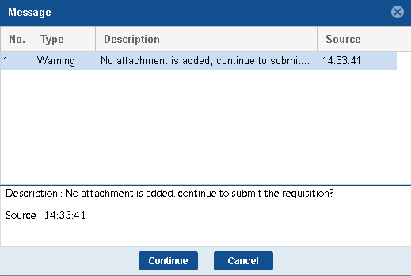
Policy enforcement and compliance Built-In Policy Checks
Enable mandatory fields for compliance
Notes:
To address the policy compliance issue, the system allow you to set up the compliance requirements like submitting supporting document as attachments,

Slide 34
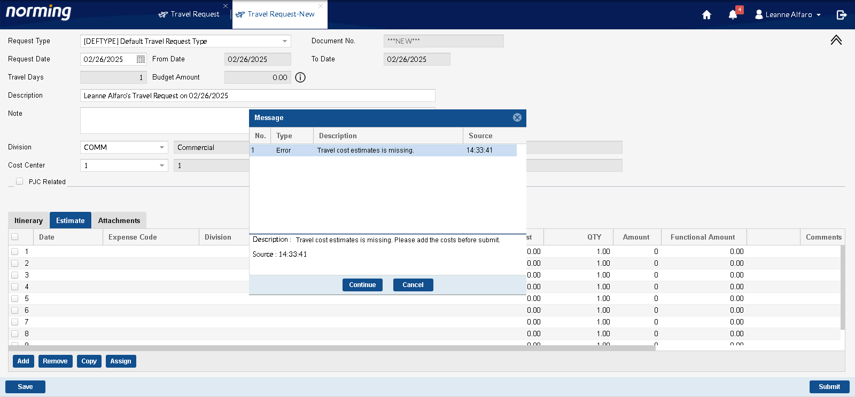
Policy enforcement and compliance Built-In Policy Checks
Notes:
Provide validation for information completeness

Slide 35
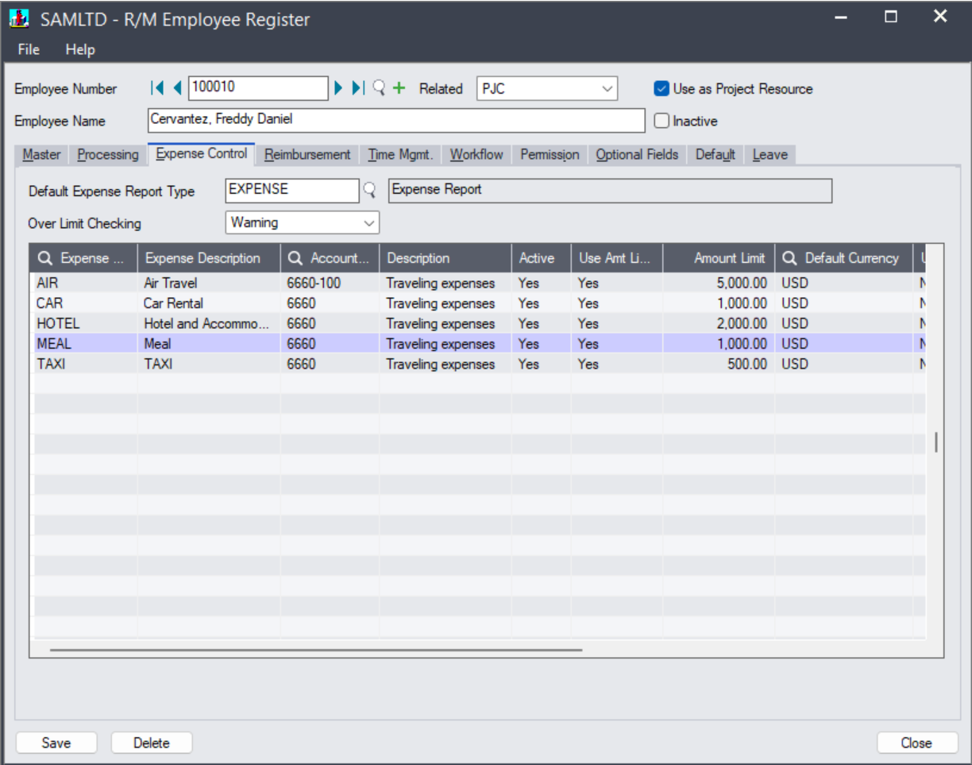
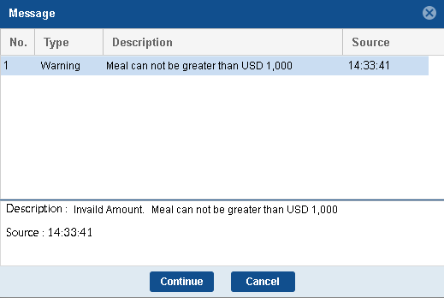
Policy enforcement and compliance Built-In Policy Checks
Set spending limits for each expenditure type
Notes:
And policy for different expenditure categories – like meals can be greater than certain amount

Slide 36
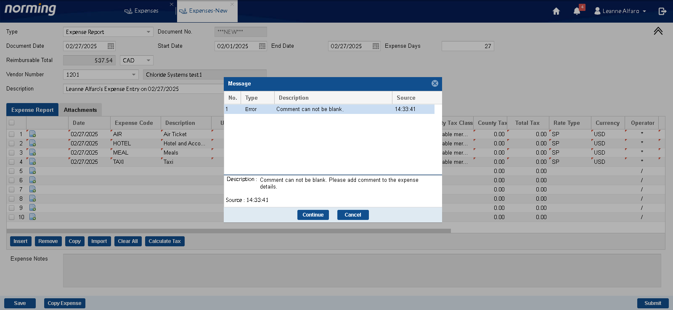
Policy enforcement and compliance Built-In Policy Checks
Enable mandatory fields for compliance
Notes:
And make the comments to be mandatory to facilitate approval process and reporting

Slide 37
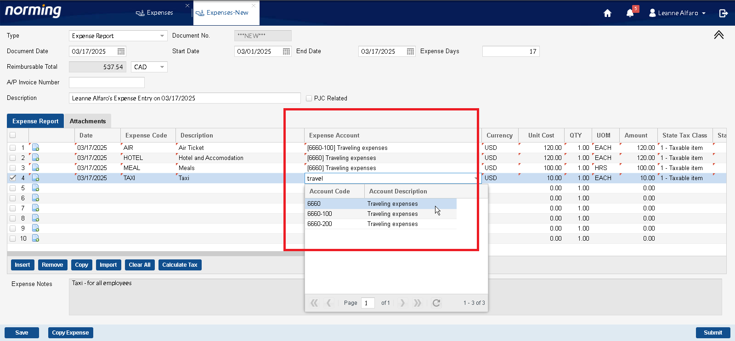
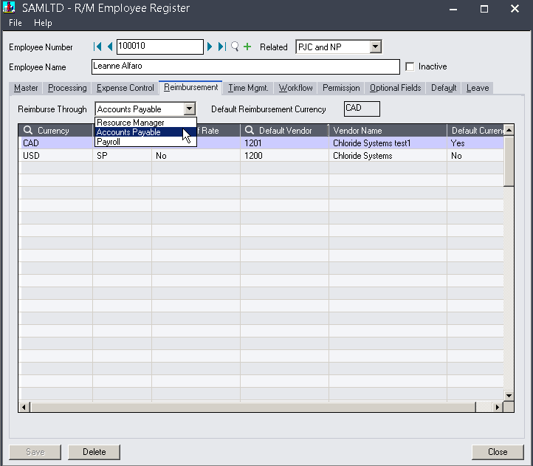
Seamless Integration with Sage 300
Define reimbursement through Sage 300 AP
Sync with Sage 300 GL Accounts
Notes:
After the expense submission has been approved properly, now comes accounting booking. As you can see, each expense is mapped to GL expense account during set up and defined reimbursement through Sage 300 AP, or Payroll or Norming Resource Manager.

Slide 38
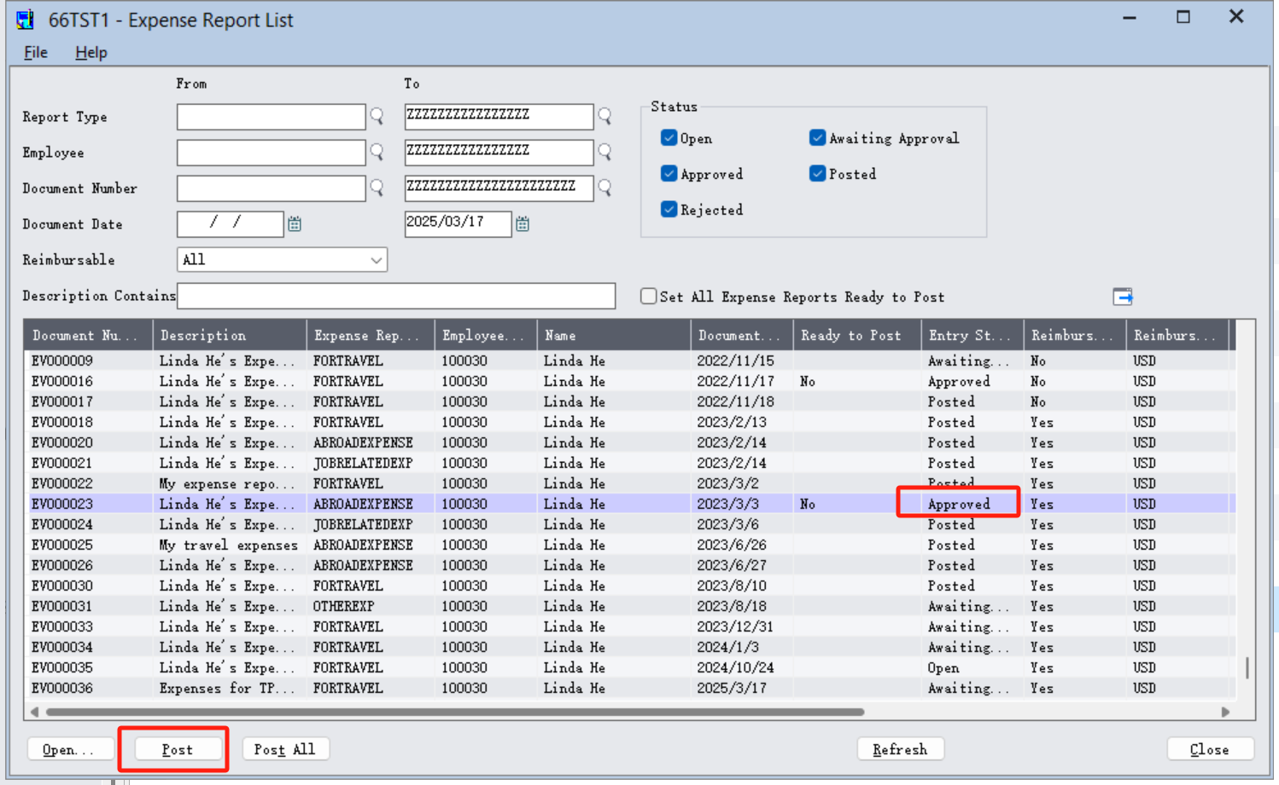
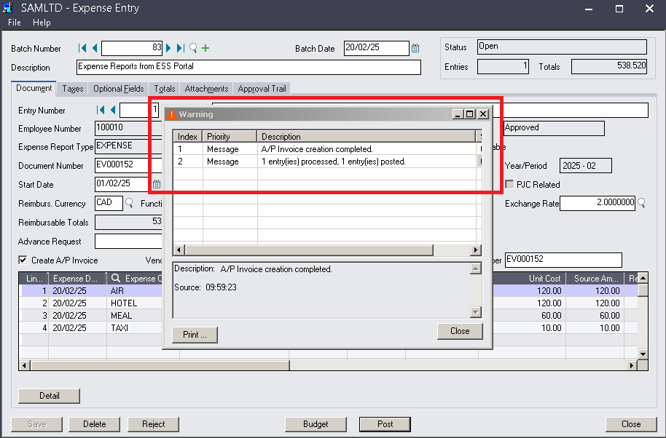
Seamless Integration with Sage 300
AP Invoice is created upon posting.
Approved expense claim is posted to Sage 300
Notes:
Upon approval, the expense reports can be converted automatically into Sage 300 AP as AP invoices, the auto posting from Norming Travel and Expense module to Sage 300 eliminate the data entry process by busy Finance Team, and it will reduce manual entry errors.

Slide 39
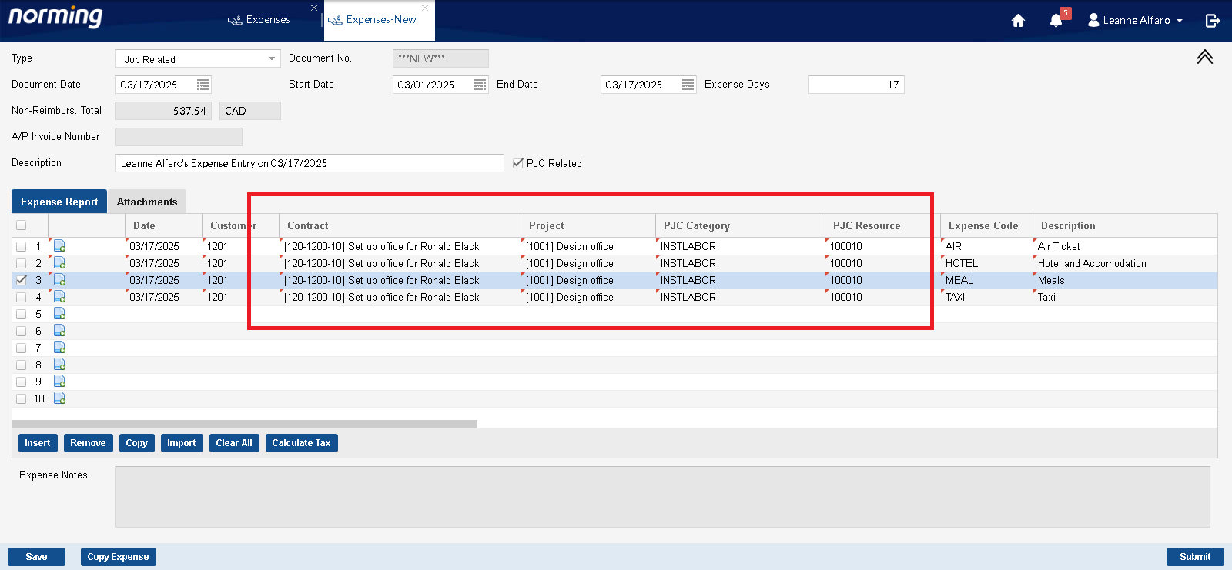
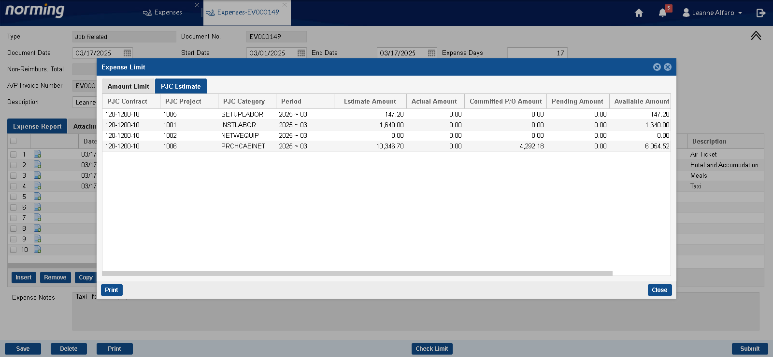
Seamless Integration with Sage 300
Expense can be linked to projects if Sage 300 PJC is used
Notes:
If you company is using Sage 300 Project Job Costing module, the system also allows you to link expenses directly to specific projects or jobs, allowing for accurate tracking of project costs against allocated budgets.

Slide 40
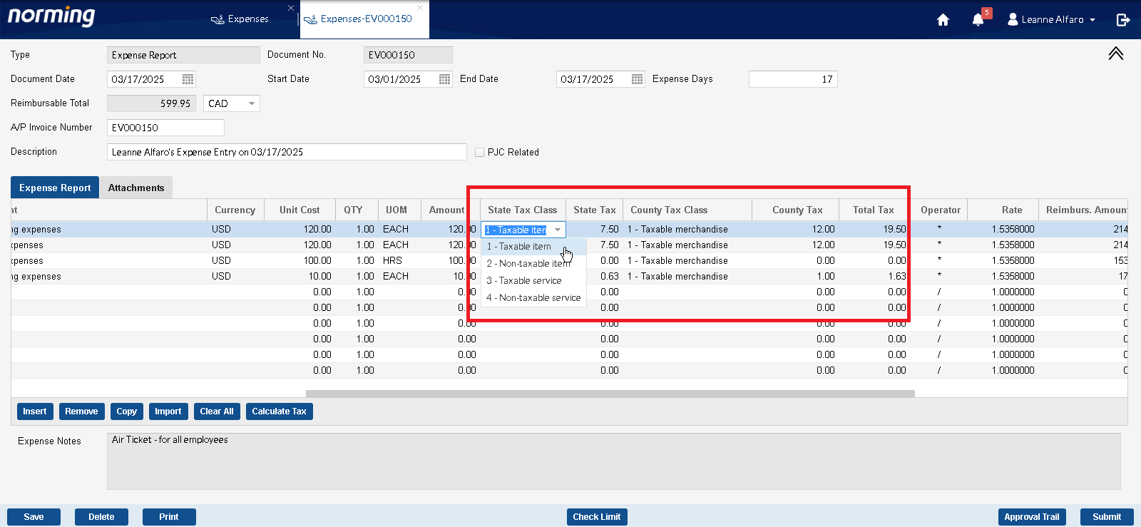
Seamless Integration with Sage 300
Link to tax set up in Sage 300
Notes:
The expense claim module integrates with Sage 300 tax services, ensuring that all expenses are categorized appropriately for tax reporting within the Sage 300 AP module

Slide 41
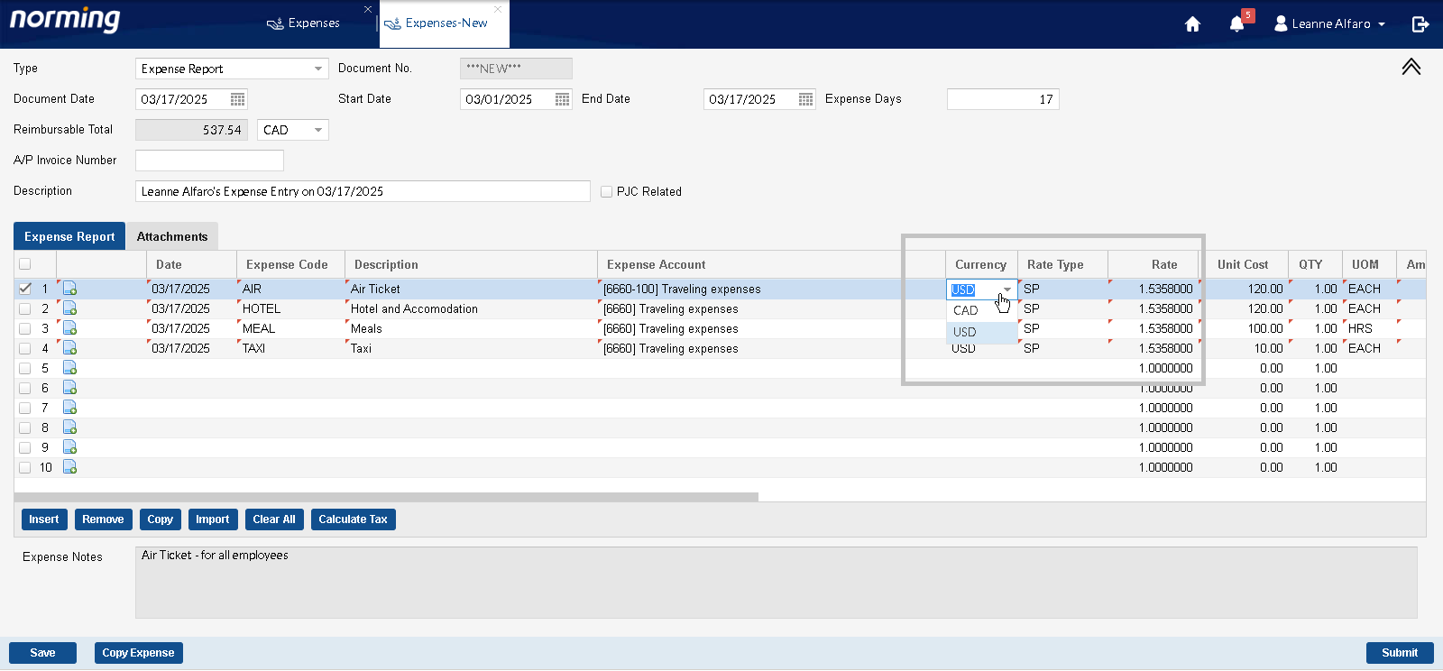
Seamless Integration with Sage 300
Exchange rate can be specified and displayed
Notes:
The solution can handle expenses in various currencies, with automatic conversion based on specific exchange rates.

Slide 42
Unlock Growth & Efficiency with Norming’s Smart T&E Solution
🚧 Challenges in Travel & Expense Management
❌ Process Delays → Causes inefficiencies and frustration. ❌ Approval Bottlenecks → Slows down business operations. ❌ Lack of Budget Control → Leads to overspending and compliance risks. ❌ Limited Visibility → No real-time tracking or reporting. ❌ Policy Compliance Issues → Risk of errors and non-compliant claims.
✅ How Norming Solves These Challenges
✔ Automated Web & Mobile Workflows – Speeds up approvals and reduces delays. ✔ Configurable Approval Paths – Multi-level approval with mobile & delegated options. ✔ Real-Time Budget Tracking – Ensures financial control and prevents overspending. ✔ Traceable Approval Status – Enhances visibility across departments. ✔ Built-in Policy Checks – Enforces compliance seamlessly. ✔ Seamless Integration with Sage 300 – Syncs expense data with finance systems for accuracy.
Notes:
Before we move on to the product demo, let’s have a recap on how Norming’s travel and expense management solution can address the key challenges.

Slide 43
Product Demo

Slide 44
Transform Your T&E Today!
Scan the QR code:
Complete the survey
Get a copy of today’s Presentation Slide
Book a demo
Contact us : contact@erpadvanceasia.com
https://forms.office.com/r/jCfpCh3NfK

Slide 45
Thank You !

